Slide 1
Normal distribution

Slide 2
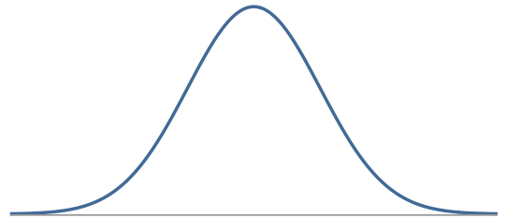
Normal Distribution
Symmetric, bell shaped curve
Many variables are nearly normal, but none are exactly normal
Denoted as N(µ, σ) → Normal with mean µ and standard deviation σ

Slide 3
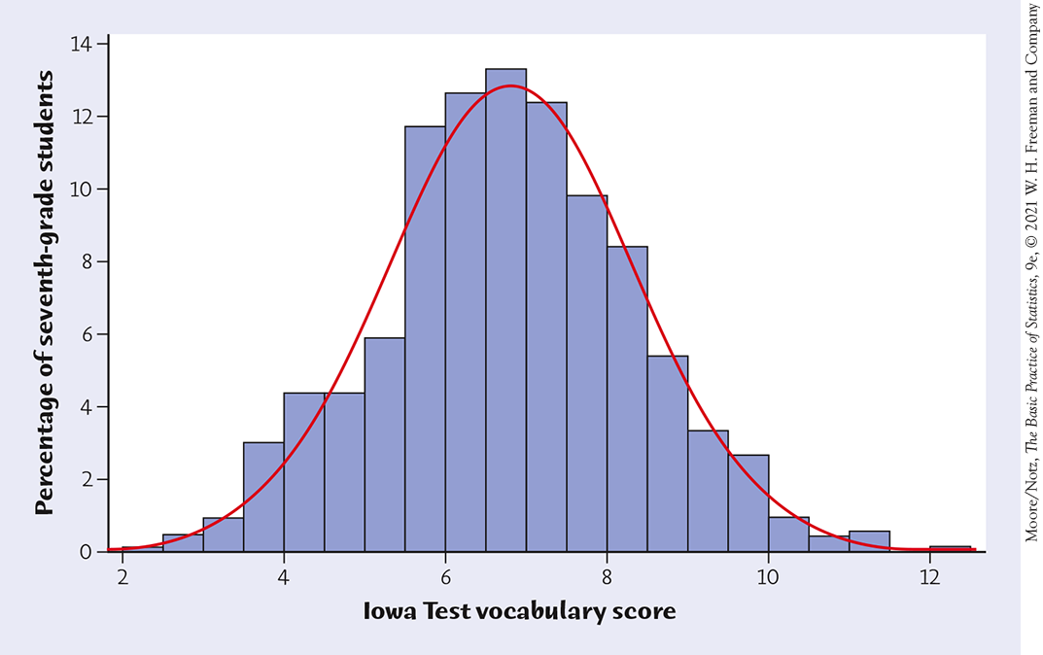
Density Curves
Example: Here is a histogram of the vocabulary scores of 947 seventh-graders.
The smooth curve closely approximates the tops of the histogram bars and provides a good description of the overall data pattern.

Slide 4
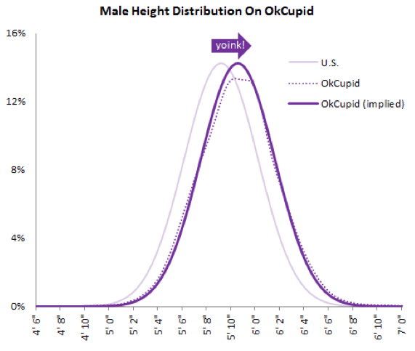
Heights of males
“The male heights on OkCupid very nearly follow the expected normal distribution -- except the whole thing is shifted to the right of where it should be. Almost universally guys like to add a couple inches.”
“You can also see a more subtle vanity at work: starting at roughly 5' 8", the top of the dotted curve tilts even further rightward. This means that guys as they get closer to six feet round up a bit more than usual, stretching for that coveted psychological benchmark.”
http://blog.okcupid.com/index.php/the-biggest-lies-in-online-dating

Slide 5
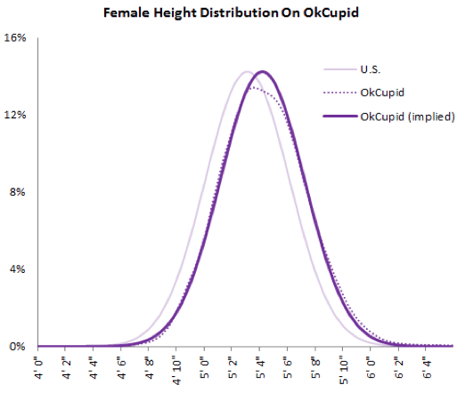
Heights of females
“When we looked into the data for women, we were surprised to see height exaggeration was just as widespread, though without the lurch towards a benchmark height.”
http://blog.okcupid.com/index.php/the-biggest-lies-in-online-dating

Slide 6
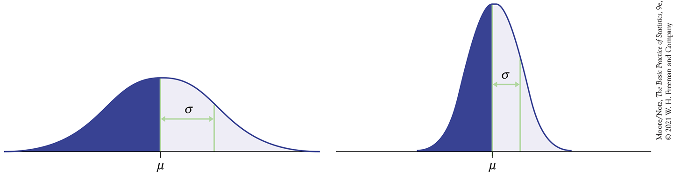
Normal distributions with different parameters

Slide 7
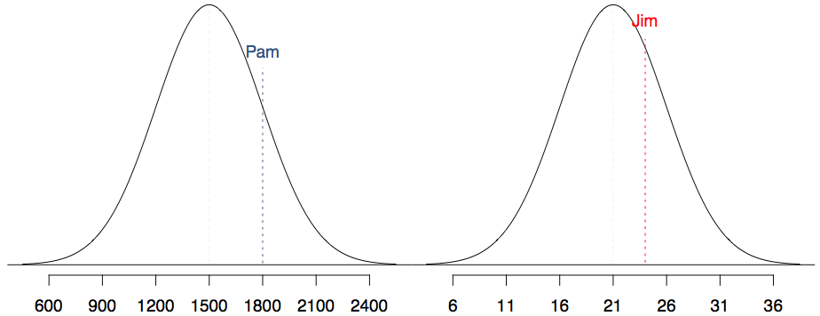
SAT scores are distributed nearly normally with mean 1500 and standard deviation 300. ACT scores are distributed nearly normally with mean 21 and standard deviation 5. A college admissions officer wants to determine which of the two applicants scored better on their standardized test with respect to the other test takers: Pam, who earned an 1800 on her SAT, or Jim, who scored a 24 on his ACT?

Slide 8
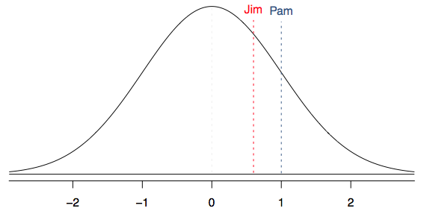
Standardizing with Z scores
Since we cannot just compare these two raw scores, we instead compare how many standard deviations beyond the mean each observation is.
Pam's score is (1800 - 1500) / 300 = 1 standard deviation above the mean.
Jim's score is (24 - 21) / 5 = 0.6 standard deviations above the mean.

Slide 9
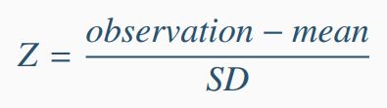
Standardizing with Z scores (cont.)
These are called standardized scores, or Z scores.
Z score of an observation is the number of standard deviations it falls above or below the mean.
Observations that are more than 2 SD away from the mean are usually considered unusual. (Some books use 3 SD)

Slide 10
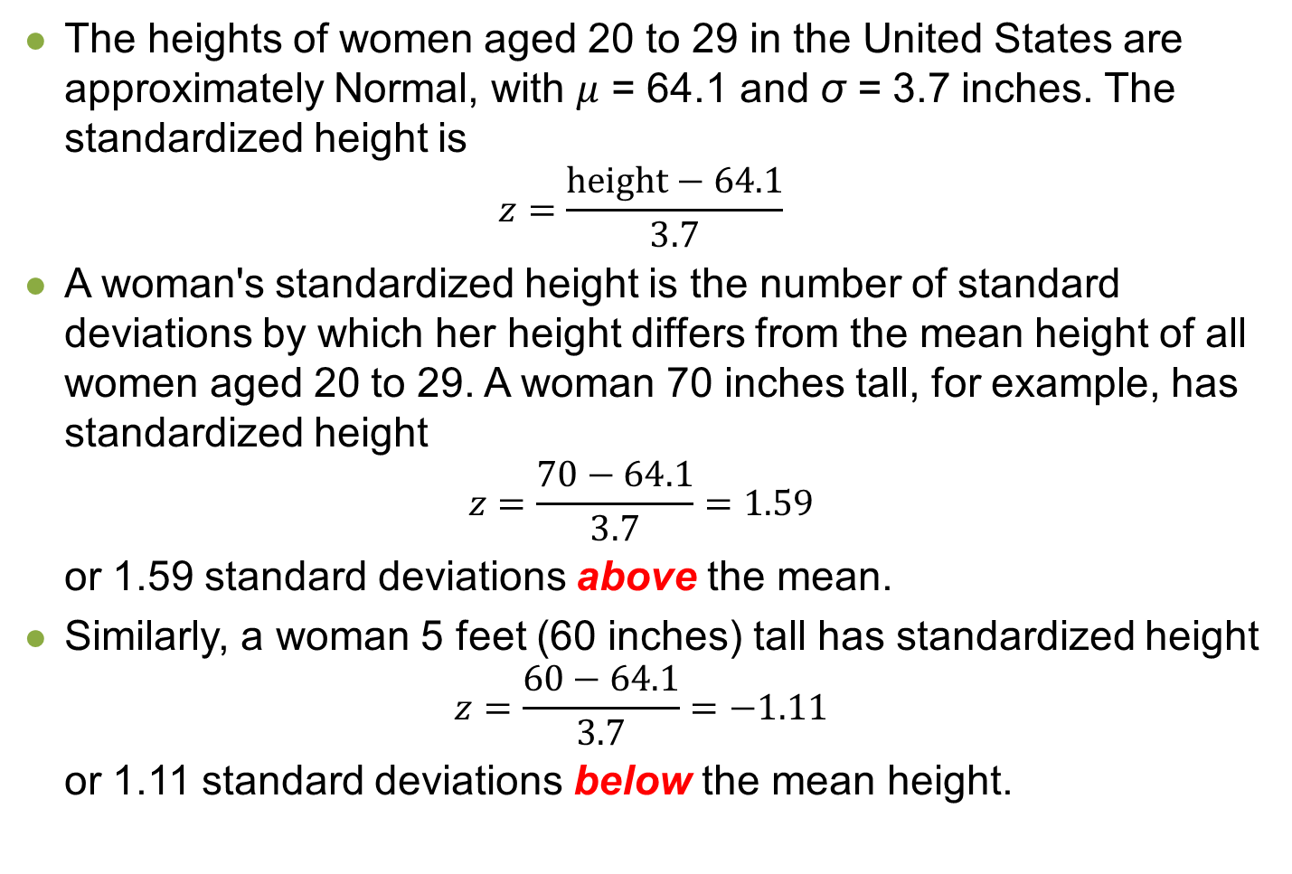
Standardizing with Z scores (cont.)
The heights of women aged 20 to 29 in the United States are approximately Normal, with $μ$ = 64.1 and σ = 3.7 inches. The standardized height is
$$z=\frac{\text{height}−64.1}{3.7}$$
A woman's standardized height is the number of standard deviations by which her height differs from the mean height of all women aged 20 to 29. A woman 70 inches tall, for example, has standardized height
$$z=\frac{\text{70}−64.1}{3.7}=1.59$$
or 1.59 standard deviations above the mean.
Similarly, a woman 5 feet (60 inches) tall has standardized height
$$z=\frac{\text{6}\text{0}−64.1}{3.7}=−1.11$$
or 1.11 standard deviations below the mean height.

Slide 11
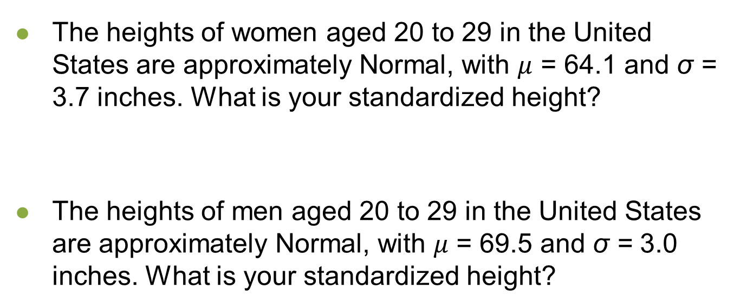
Practice
The heights of women aged 20 to 29 in the United States are approximately Normal, with $μ$ = 64.1 and σ = 3.7 inches. What is your standardized height?
The heights of men aged 20 to 29 in the United States are approximately Normal, with $μ$ = 69.5 and σ = 3.0 inches. What is your standardized height?

Slide 12
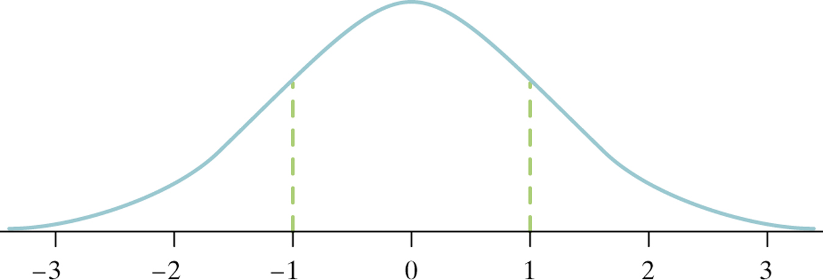
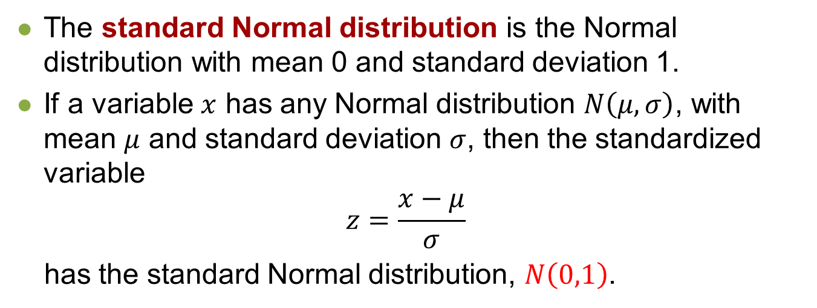
The Standard Normal Distribution
The standard Normal distribution is the Normal distribution with mean 0 and standard deviation 1.
If a variable $x$ has any Normal distribution $N\left(μ,σ\right)$, with mean $μ$ and standard deviation $σ$, then the standardized variable
$$z=\frac{x−μ}{σ}$$
has the standard Normal distribution, $N\left(0,1\right)$.

Slide 13
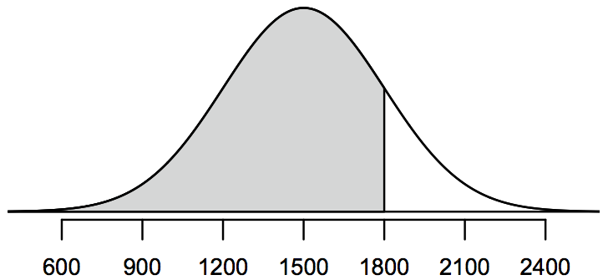
Percentiles
Percentile is the percentage of observations that fall below a given data point.
Graphically, percentile is the area below the probability distribution curve to the left of that observation.

Slide 14
Calculating percentiles -
using computation
There are many ways to compute percentiles/areas under the curve. R:

Slide 15
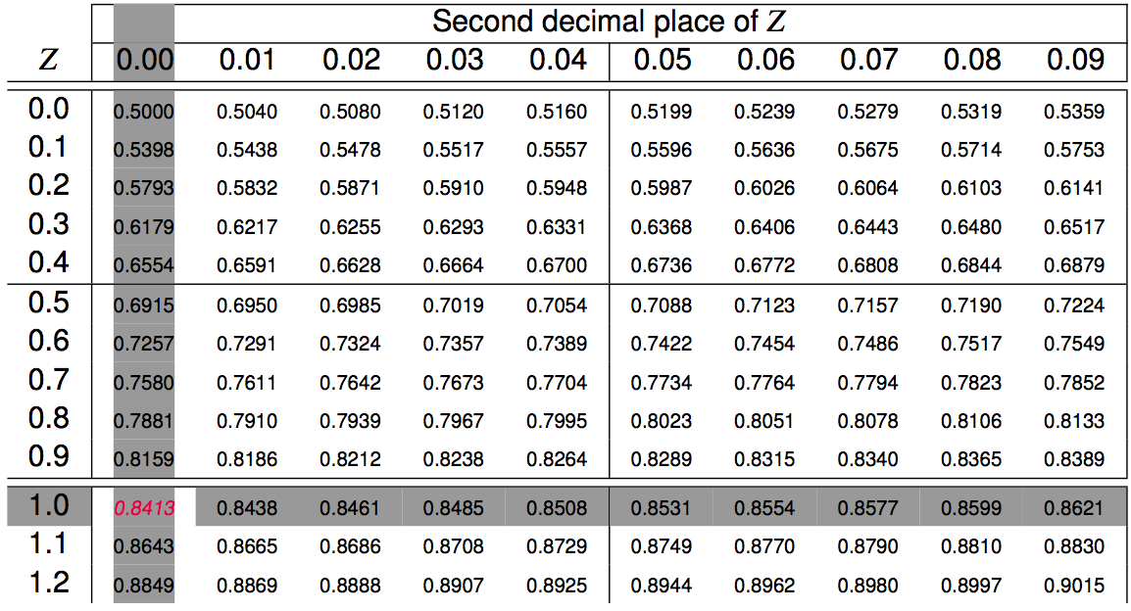
Calculating percentiles -
using tables

Slide 16
Quality control
At Heinz ketchup factory the amounts which go into bottles of ketchup are supposed to be normally distributed with mean 36 oz. and standard deviation 0.11 oz. Once every 30 minutes a bottle is selected from the production line, and its contents are noted precisely. If the amount of ketchup in the bottle is below 35.8 oz. or above 36.2 oz., then the bottle fails the quality control inspection. What percent of bottles have less than 35.8 ounces of ketchup?

Slide 17
Quality control
At Heinz ketchup factory the amounts which go into bottles of ketchup are supposed to be normally distributed with mean 36 oz. and standard deviation 0.11 oz. Once every 30 minutes a bottle is selected from the production line, and its contents are noted precisely. If the amount of ketchup in the bottle is below 35.8 oz. or above 36.2 oz., then the bottle fails the quality control inspection. What percent of bottles have less than 35.8 ounces of ketchup?
Let X = amount of ketchup in a bottle: X ~ N(µ = 36, σ = 0.11)

Slide 18
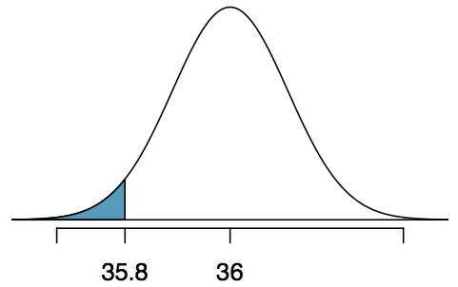
Quality control
At Heinz ketchup factory the amounts which go into bottles of ketchup are supposed to be normally distributed with mean 36 oz. and standard deviation 0.11 oz. Once every 30 minutes a bottle is selected from the production line, and its contents are noted precisely. If the amount of ketchup in the bottle is below 35.8 oz. or above 36.2 oz., then the bottle fails the quality control inspection. What percent of bottles have less than 35.8 ounces of ketchup?
Let X = amount of ketchup in a bottle: X ~ N(µ = 36, σ = 0.11)

Slide 19
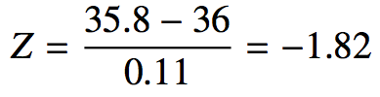
Quality control
At Heinz ketchup factory the amounts which go into bottles of ketchup are supposed to be normally distributed with mean 36 oz. and standard deviation 0.11 oz. Once every 30 minutes a bottle is selected from the production line, and its contents are noted precisely. If the amount of ketchup in the bottle is below 35.8 oz. or above 36.2 oz., then the bottle fails the quality control inspection. What percent of bottles have less than 35.8 ounces of ketchup?
Let X = amount of ketchup in a bottle: X ~ N(µ = 36, σ = 0.11)

Slide 20
Finding the exact probability - using R
> pnorm(-1.82, mean = 0, sd = 1)
[1] 0.0344
OR
> pnorm(35.8, mean = 36, sd = 0.11)
[1] 0.0345

Slide 21
Practice
What percent of bottles pass the quality control inspection?
(a) 1.82% (c) 6.88%
(b) 3.44% (d) 93.12%

Slide 22
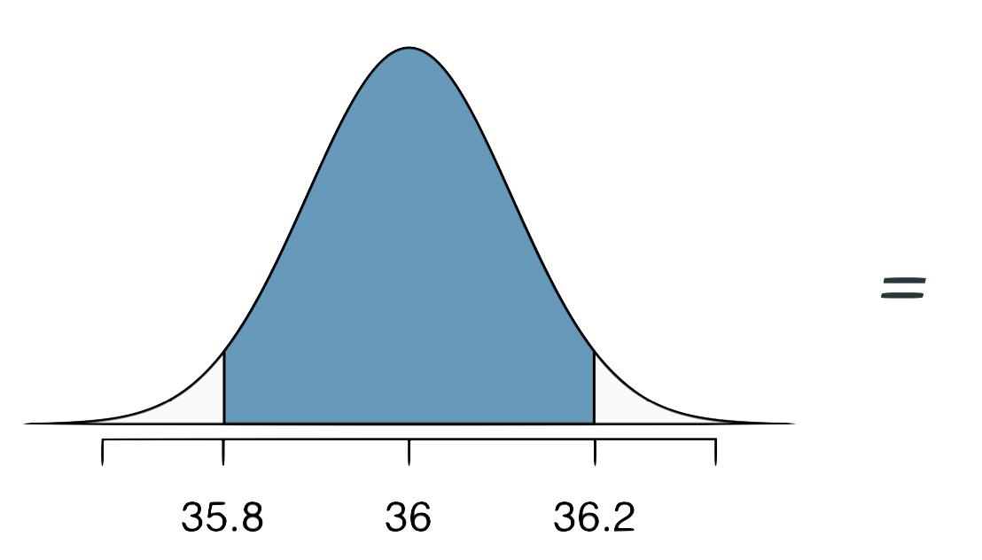
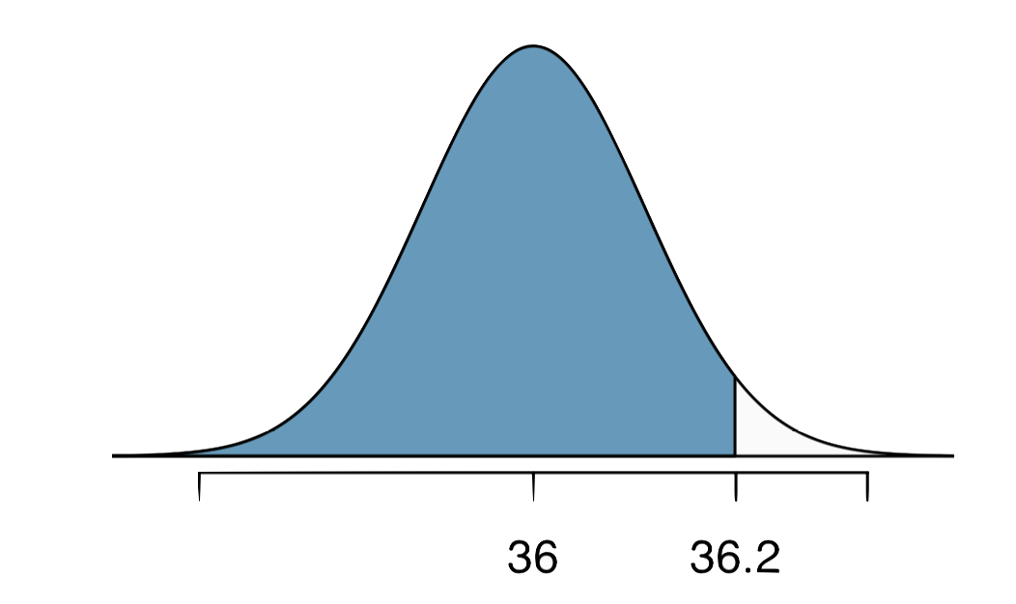
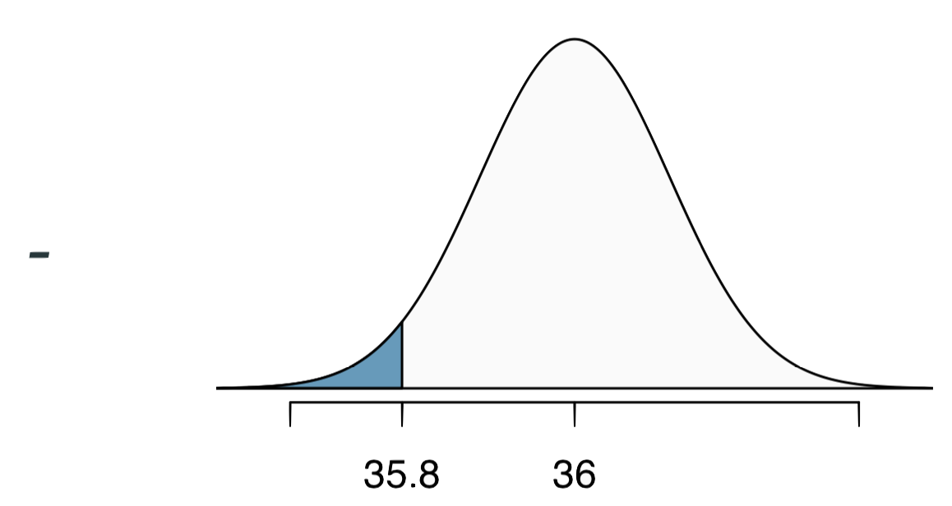
Practice
What percent of bottles pass the quality control inspection?
(a) 1.82% (c) 6.88%
(b) 3.44% (d) 93.12%

Slide 23
Finding cutoff points
Body temperatures of healthy humans are distributed nearly normally with mean 98.2ºF and standard deviation 0.73ºF. What is the cutoff for the lowest 3% of human body temperatures?

Slide 24
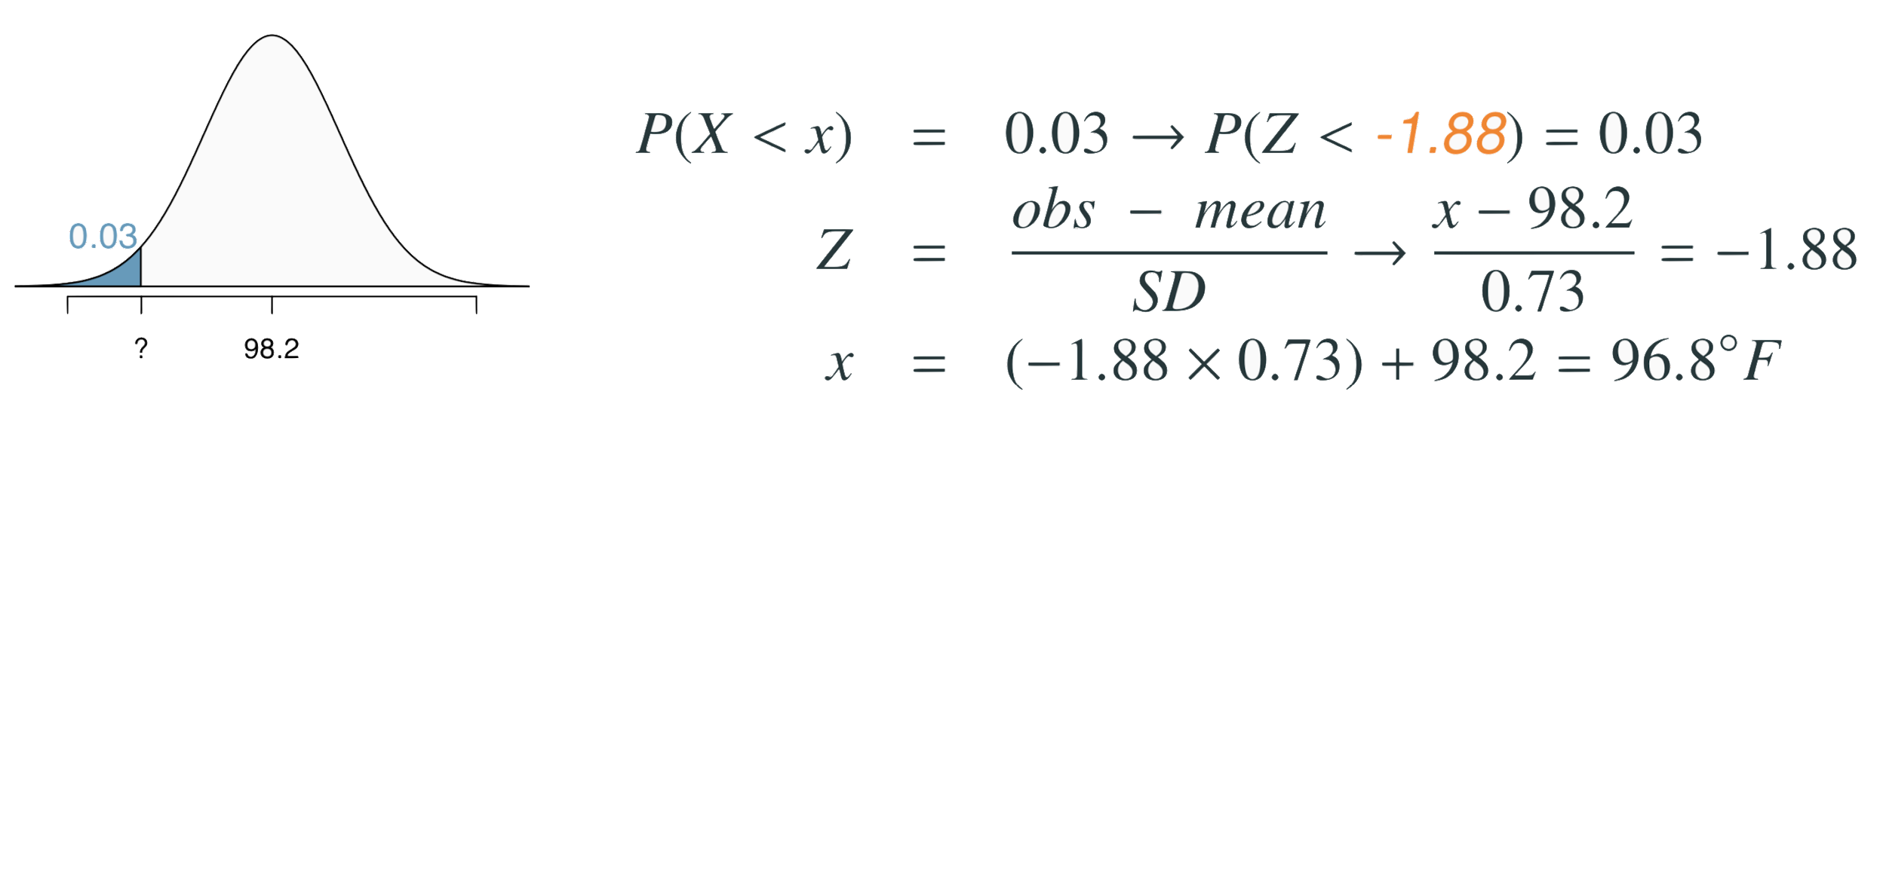
Finding cutoff points
Body temperatures of healthy humans are distributed nearly normally with mean 98.2ºF and standard deviation 0.73ºF. What is the cutoff for the lowest 3% of human body temperatures?

Slide 25
Finding cutoff points
Body temperatures of healthy humans are distributed nearly normally with mean 98.2ºF and standard deviation 0.73ºF. What is the cutoff for the lowest 3% of human body temperatures?

Slide 26
Finding cutoff points
Body temperatures of healthy humans are distributed nearly normally with mean 98.2ºF and standard deviation 0.73ºF. What is the cutoff for the lowest 3% of human body temperatures?

Slide 27
Finding cutoff points
Body temperatures of healthy humans are distributed nearly normally with mean 98.2ºF and standard deviation 0.73ºF. What is the cutoff for the lowest 3% of human body temperatures?

Slide 28
Finding cutoff points
Body temperatures of healthy humans are distributed nearly normally with mean 98.2ºF and standard deviation 0.73ºF. What is the cutoff for the lowest 3% of human body temperatures?
> qnorm(0.03)
[1] -1.880794
Mackowiak, Wasserman, and Levine (1992), A Critical Appraisal of 98.6 Degrees F, the Upper Limit of the Normal Body Temperature, and Other Legacies of Carl Reinhold August Wunderlick.

Slide 29
Practice
Body temperatures of healthy humans are distributed nearly nor- mally with mean 98.2ºF and standard deviation 0.73ºF. What is the cutoff for the highest 10% of human body temperatures?
(a) 97.3ºF (c) 99.4ºF
(b) 99.1ºF (d) 99.6ºF

Slide 30
Practice
Body temperatures of healthy humans are distributed nearly nor- mally with mean 98.2ºF and standard deviation 0.73ºF. What is the cutoff for the highest 10% of human body temperatures?
(a) 97.3ºF (c) 99.4ºF
(b) 99.1ºF (d) 99.6ºF

Slide 31
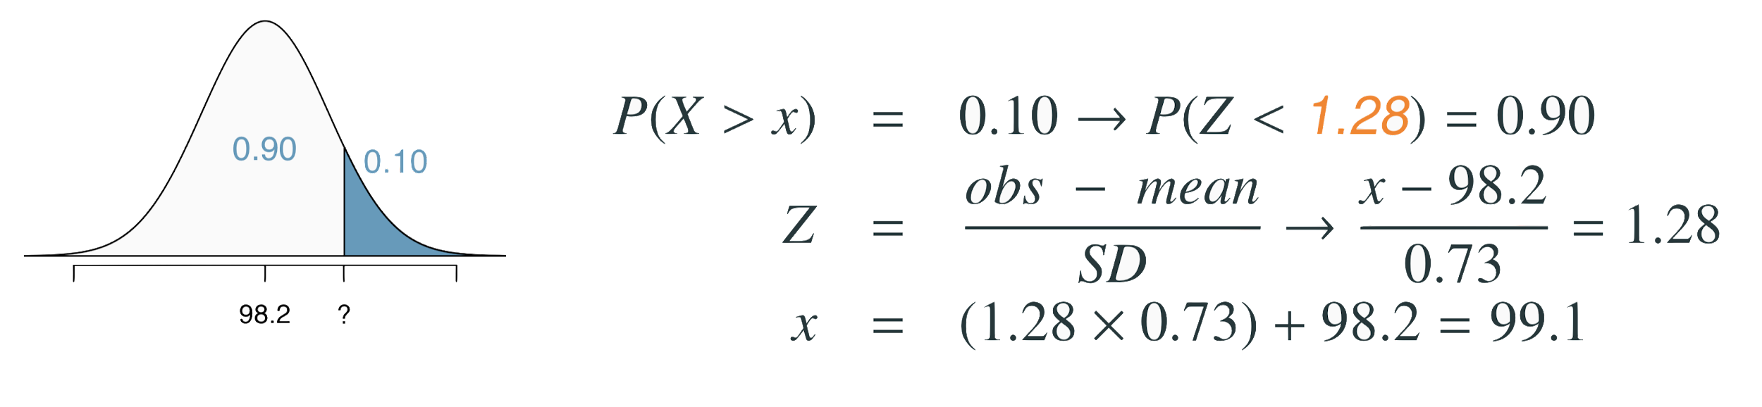
Practice
Body temperatures of healthy humans are distributed nearly nor- mally with mean 98.2ºF and standard deviation 0.73ºF. What is the cutoff for the highest 10% of human body temperatures?
(a) 97.3ºF (c) 99.4ºF
(b) 99.1ºF (d) 99.6ºF

Slide 32
Practice
Body temperatures of healthy humans are distributed nearly nor- mally with mean 98.2ºF and standard deviation 0.73ºF. What is the cutoff for the highest 10% of human body temperatures?
(a) 97.3ºF (c) 99.4ºF
(b) 99.1ºF (d) 99.6ºF

Slide 33
Practice
Body temperatures of healthy humans are distributed nearly nor- mally with mean 98.2ºF and standard deviation 0.73ºF. What is the cutoff for the highest 10% of human body temperatures?
(a) 97.3ºF (c) 99.4ºF
(b) 99.1ºF (d) 99.6ºF

Slide 34
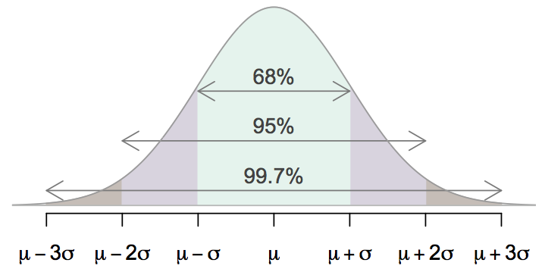
68-95-99.7 Rule
For nearly normally distributed data,
about 68% falls within 1 SD of the mean,
about 95% falls within 2 SD of the mean,
about 99.7% falls within 3 SD of the mean.
It is possible for observations to fall 4, 5, or more standard deviations away from the mean, but these occurrences are very rare if the data are nearly normal.

Slide 35
Describing variability using the 68-95-99.7 Rule
SAT scores are distributed nearly normally with mean 1500 and standard deviation 300.

Slide 36
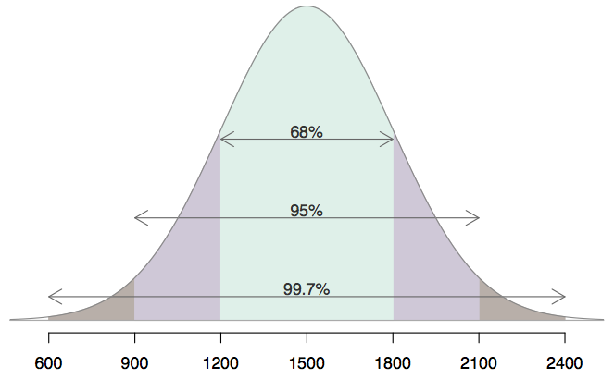
Describing variability using the 68-95-99.7 Rule
SAT scores are distributed nearly normally with mean 1500 and standard deviation 300.
~68% of students score between 1200 and 1800 on the SAT.
~95% of students score between 900 and 2100 on the SAT.
~$99.7% of students score between 600 and 2400 on the SAT.

Slide 37
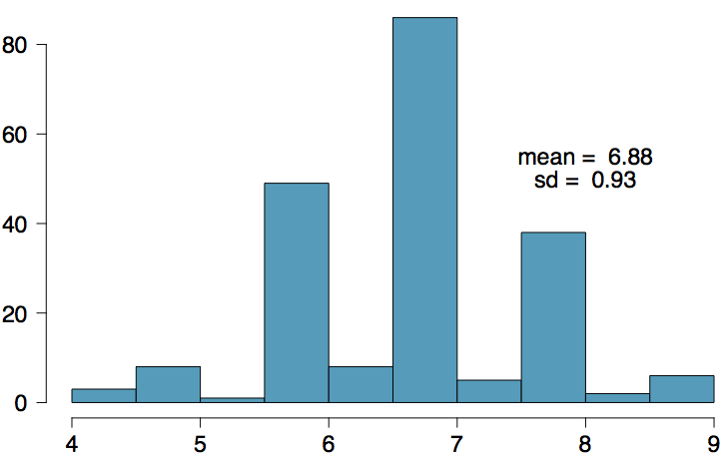
Number of hours of sleep on school nights
Mean = 6.88 hours, SD = 0.92 hrs

Slide 38
Appendix
Probability Tables

Slide 39
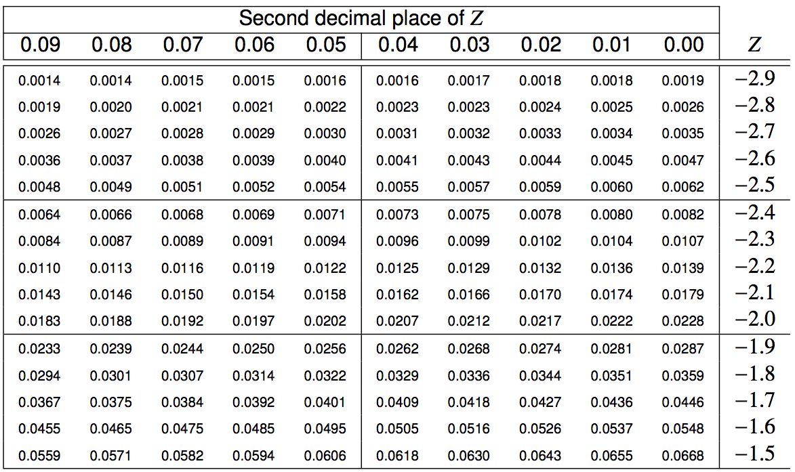
Finding the exact probability - using the Z table

Slide 40
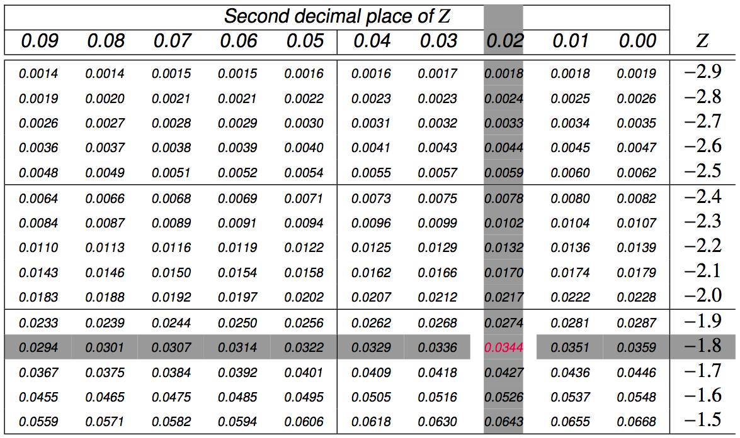
Finding the exact probability - using the Z table

